Slide 1
CENTRE for INDUSTRY
EDUCATION COLLABORATION
Sustainable fuel:
What job do I do?

Slide 2
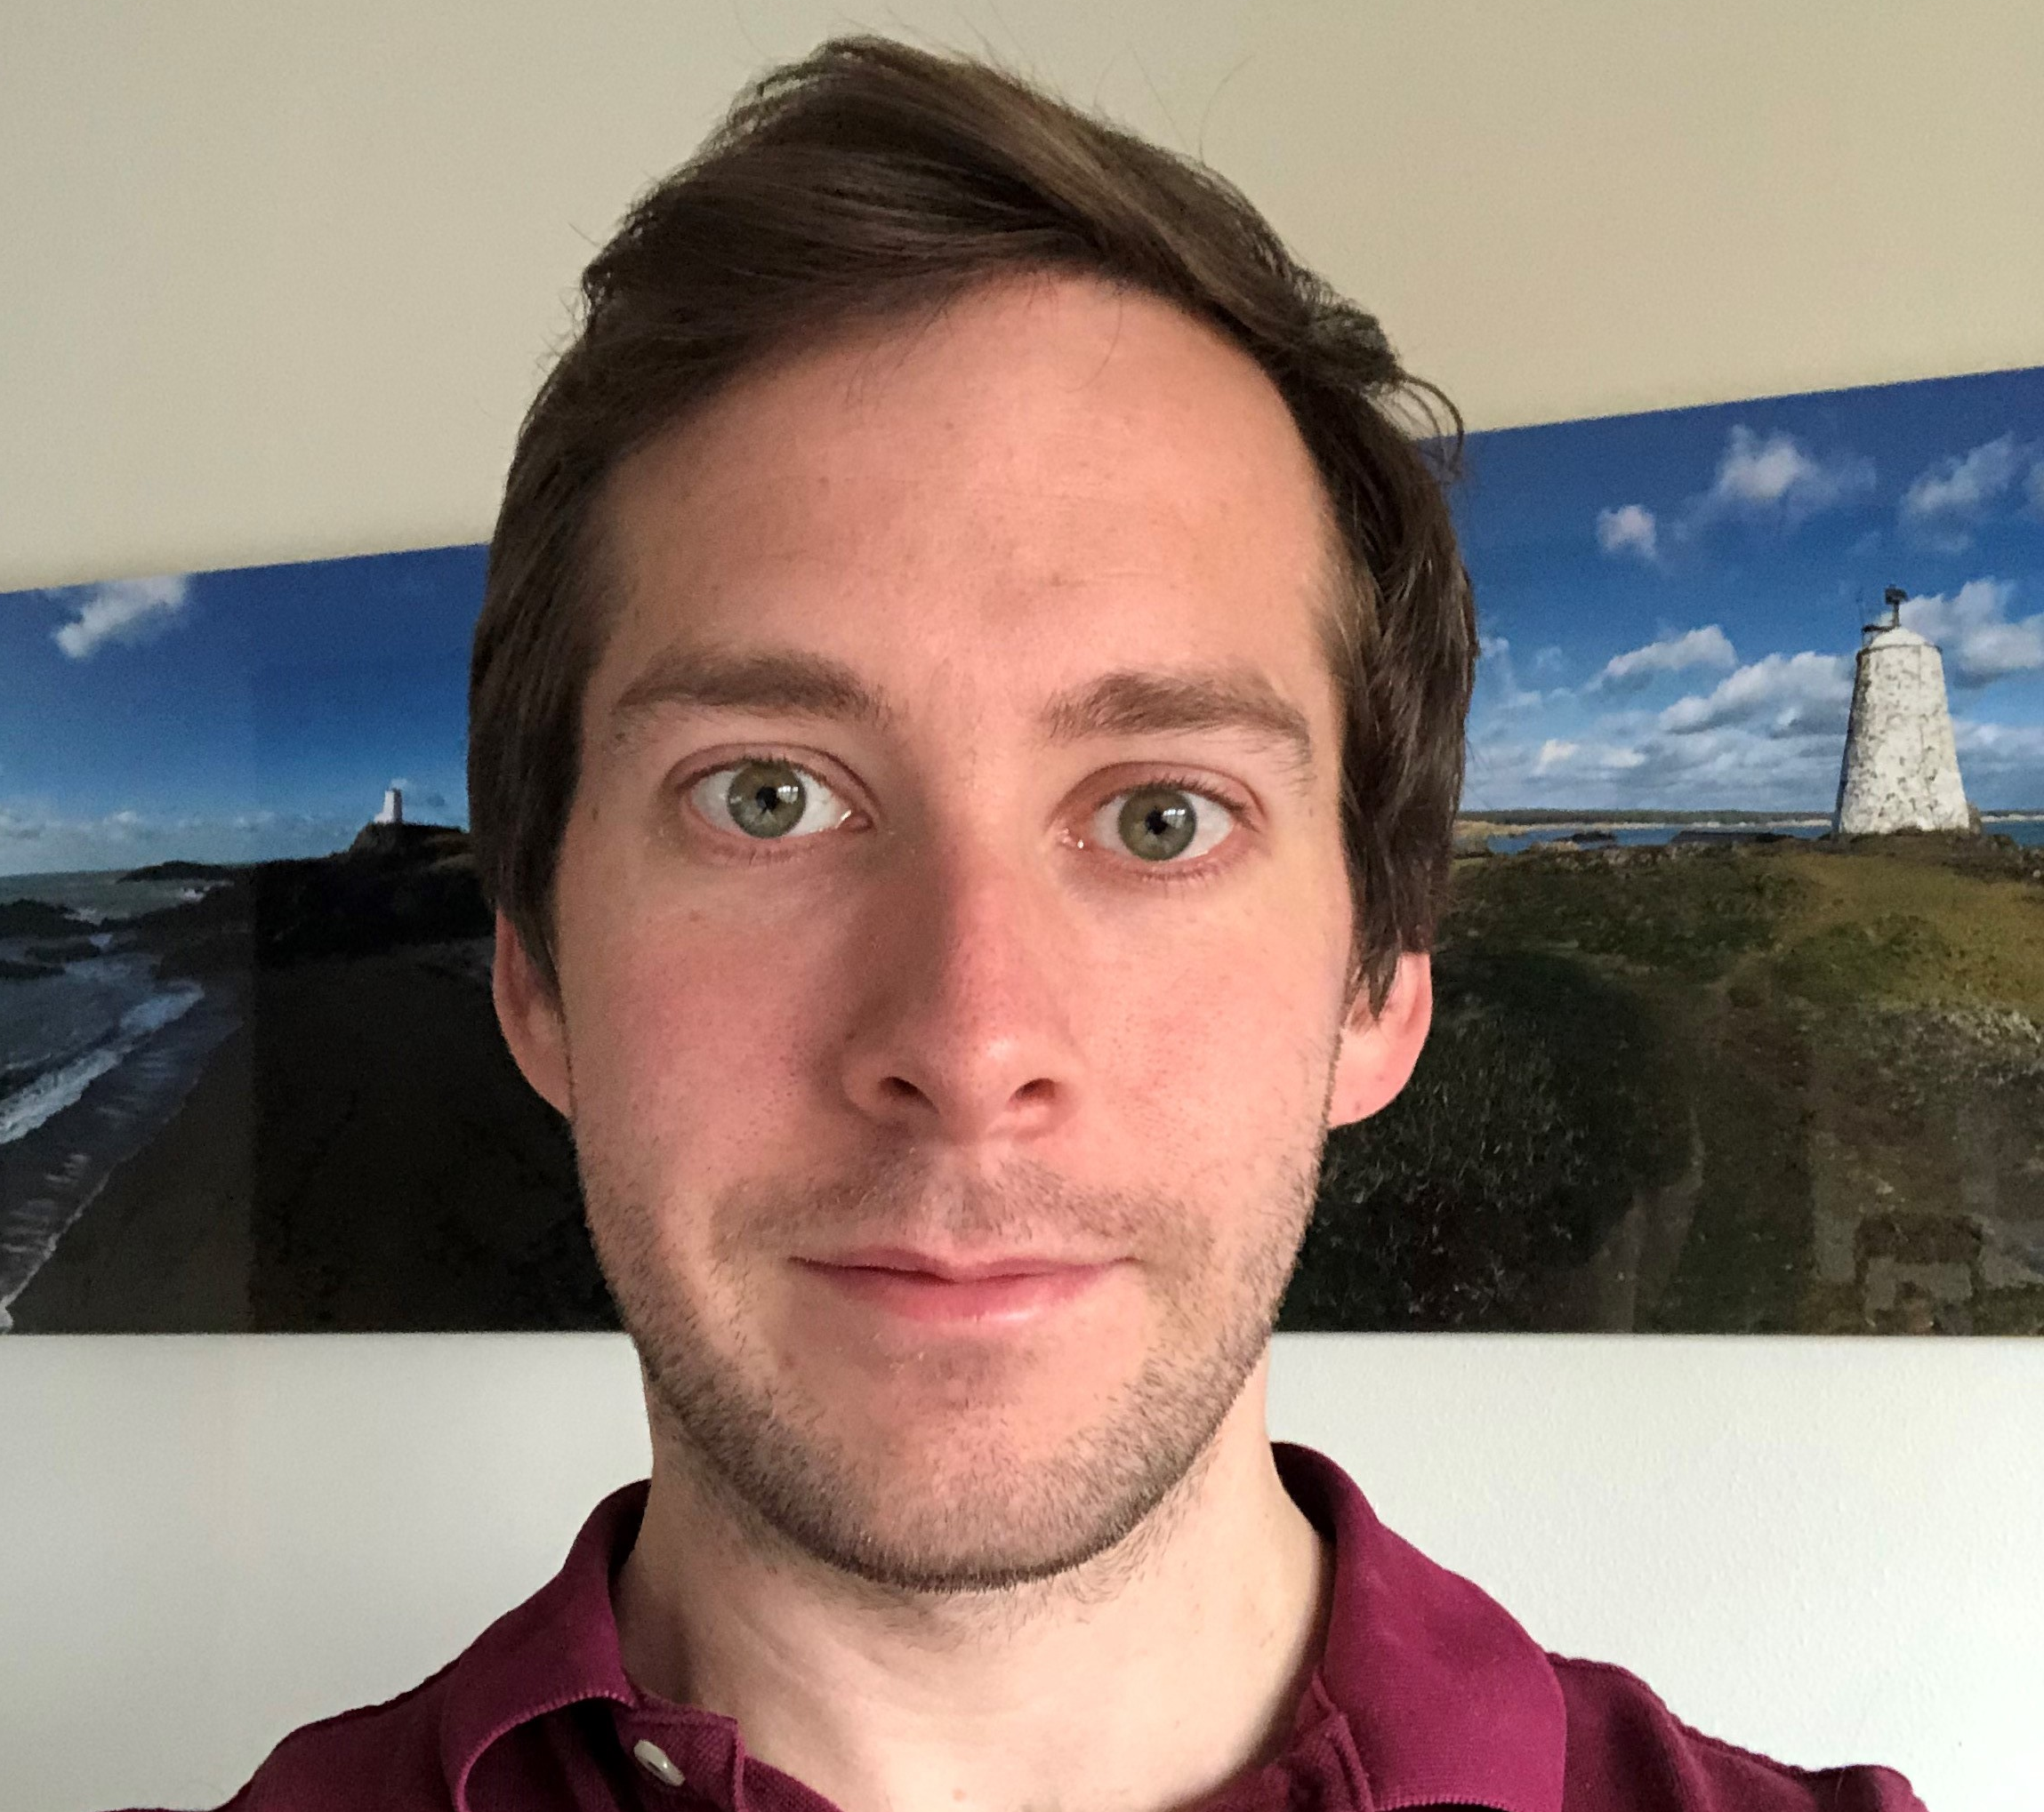
Making complicated information simple for other people to use.
Product Manager at Johnson Matthey.
WHAT ARE MY HOBBIES?
WHAT JOB
DO I DO?
I enjoy reading. I enjoy riding my bike, climbing mountains and exploring new places.
Daniel
I make sure we have everything we need to make the products our customers want.
WHAT DO I NEED TO BE GOOD AT?
WHAT DO I DO IN MY JOB?
I loved acting in school plays.
My favourite subject was science.
WHAT DID I ENJOY AT SCHOOL?

Slide 3
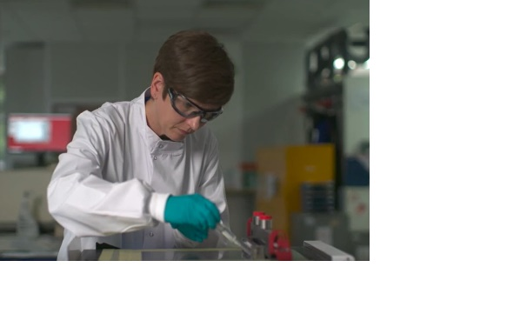
Cycling, hiking, sailing and reading a good book.
Membrane Development Manager at Johnson Matthey.
WHAT ARE MY HOBBIES?
WHAT JOB
DO I DO?
Curious, careful, a good explainer, and a good team player.
Emily
I lead a team of scientists to make membranes to go in fuel cells.
WHAT DO I NEED TO BE GOOD AT?
WHAT DO I DO IN MY JOB?
I enjoyed writing stories, maths and playing team sports.
WHAT DID I ENJOY AT SCHOOL?

Slide 4
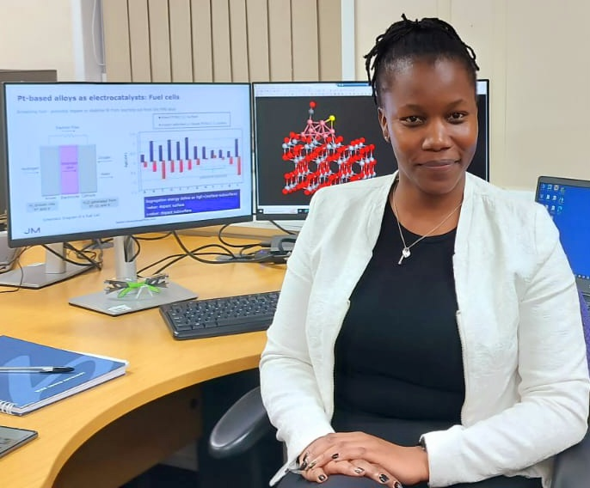
I like doing nail art, designing cards, volunteering and watching TV.
Senior scientist at Johnson Matthey.
WHAT ARE MY HOBBIES?
WHAT JOB
DO I DO?
I am good at coding, maths, problem-solving, and working in a team of scientists.
Hellen
I create computer models to improve or discover new ingredients for fuel cells.
WHAT DO I NEED TO BE GOOD AT?
WHAT DO I DO IN MY JOB?
I liked to try new things and do science challenges, like making paper boats that would float.
WHAT DID I ENJOY AT SCHOOL?

Slide 5

www.ciec.org.uk

